Slide 1
University of Cambridge
Autonomous Underwater Vehicle
Connector / Cable Assembly Requirement.

Slide 2
1. USB/Can BUS – 4 way.-2 Screened Twisted Pair.
2. Power- 2 way. 10A. 2 Core Screened.
3. Battery- 4 way 2x Power 20v. 15A + 2 Data.
4. Firewire- 6 way. Individual Screened Twisted Pair.
5. Serial- 4 way. Signal 4 core screened
Requirement

Slide 3
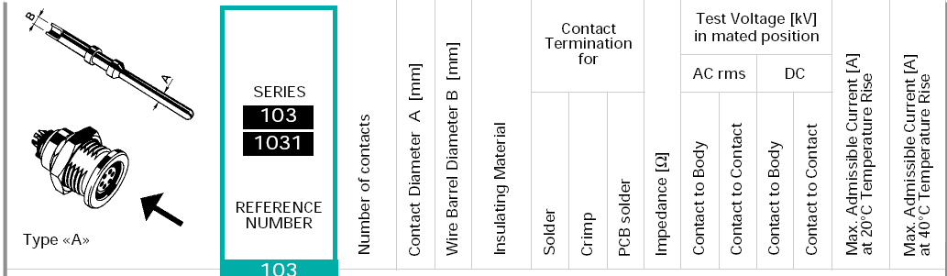
1. USB/CAN BUS
Low Volts. Low current. Data Only

Slide 4
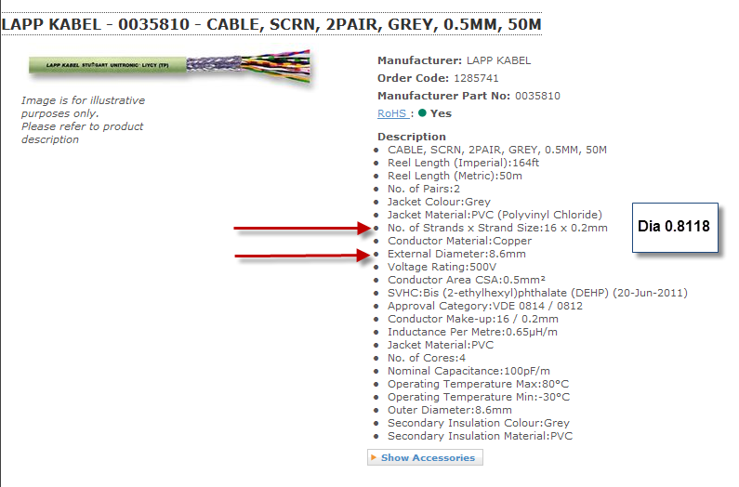

Slide 5
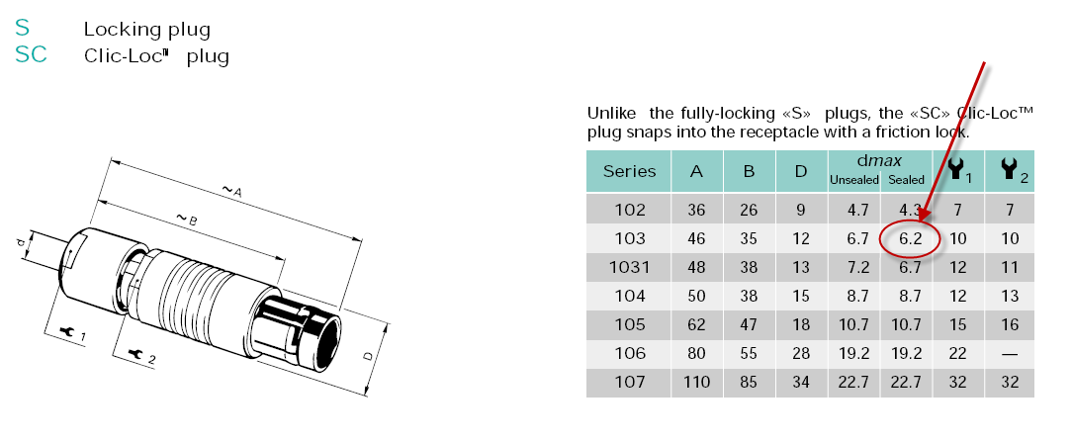
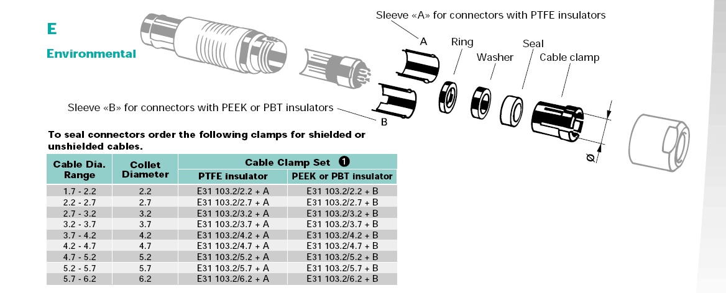

Slide 6
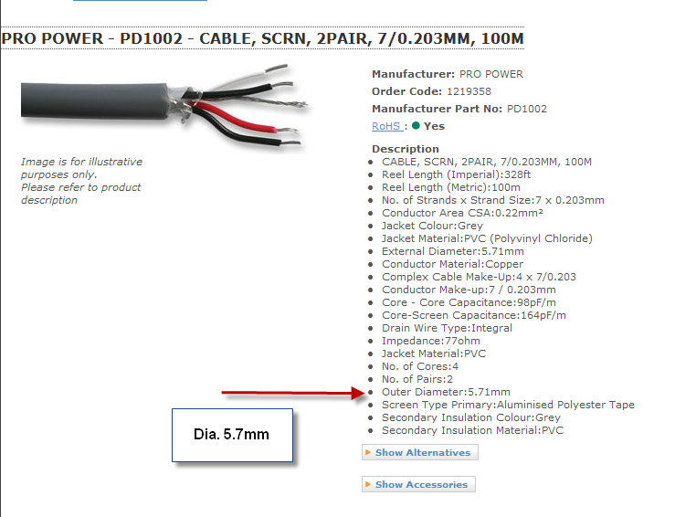

Slide 7
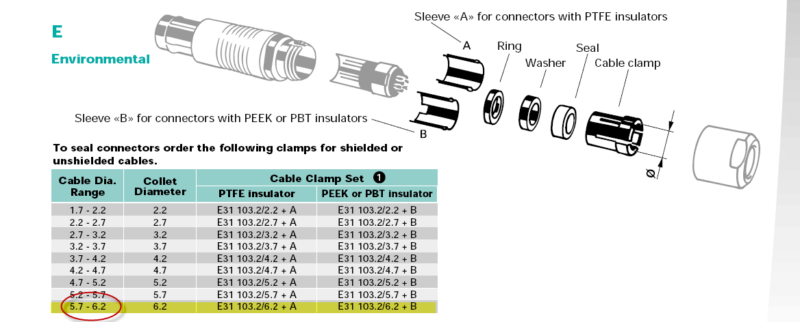

Slide 8
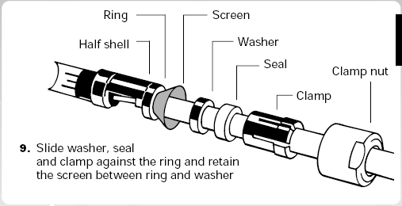

Slide 9
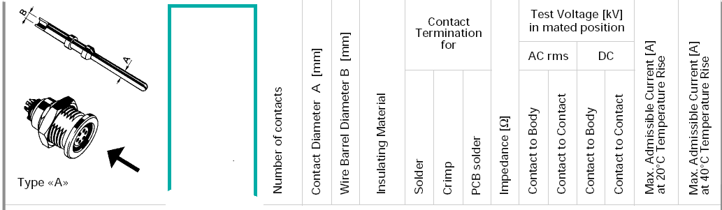

2.Power
2 way. 10A. Low Volts.

Slide 10
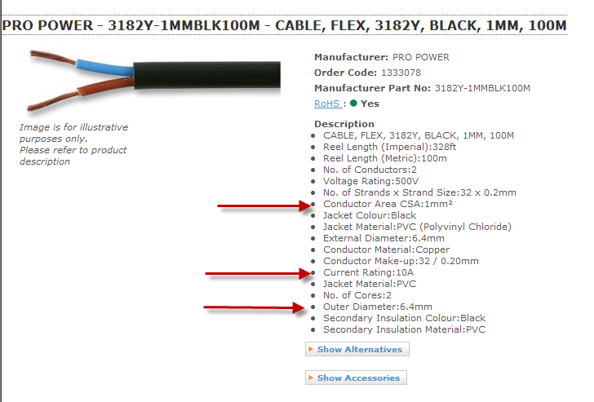
Recommended Conductor Cross Sectional Area to carry 10A = 1.0 sq.mm= 1.15mm Diameter

Slide 11
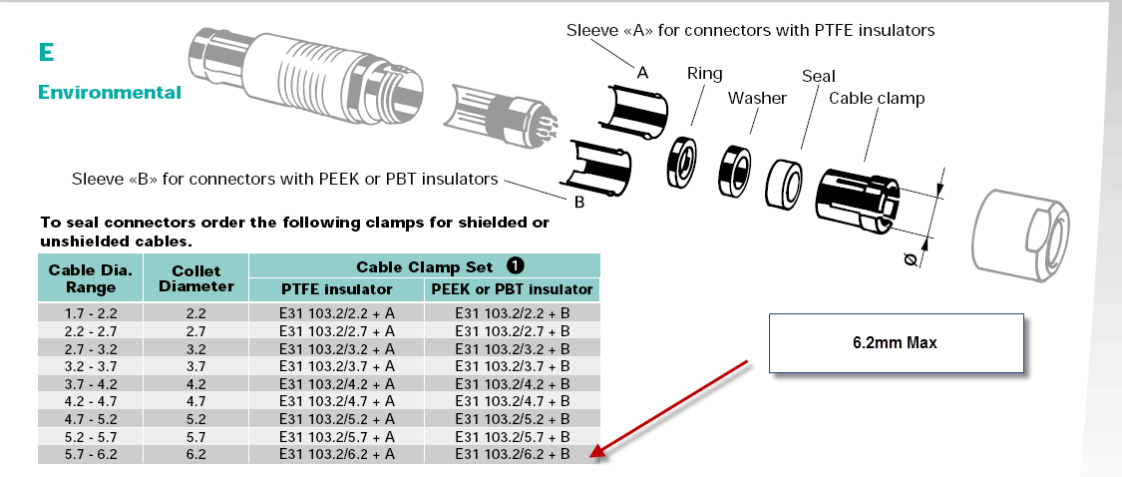
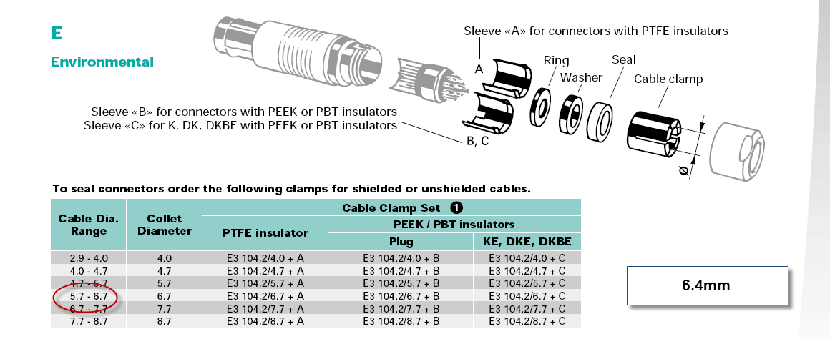
?
103 or 104

Slide 12
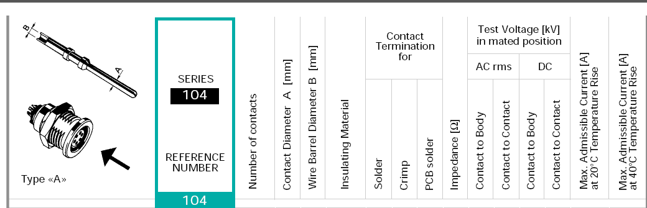

3. Battery- 4 way 2x Power 20v. 15A + 2 Data

Slide 13
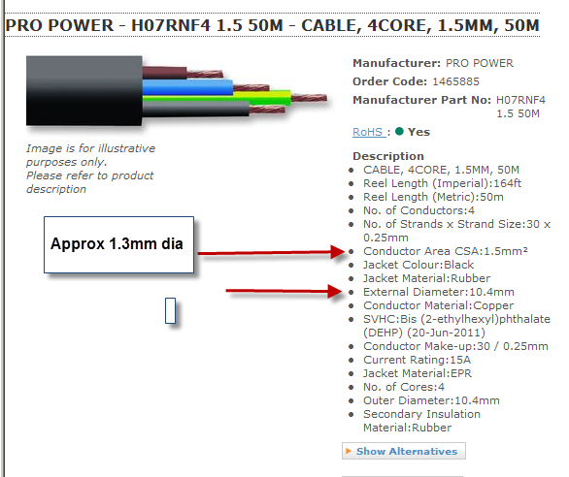
15A current requirement = 1.5 sq.mm conductor. (15/16AWG)
? Special Cable Requirement ?

Slide 14
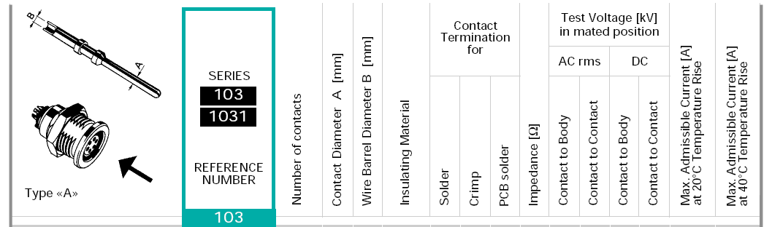
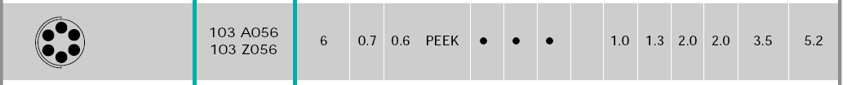
4. Firewire- 6 way. Individual Screened Twisted Pair.

Slide 15
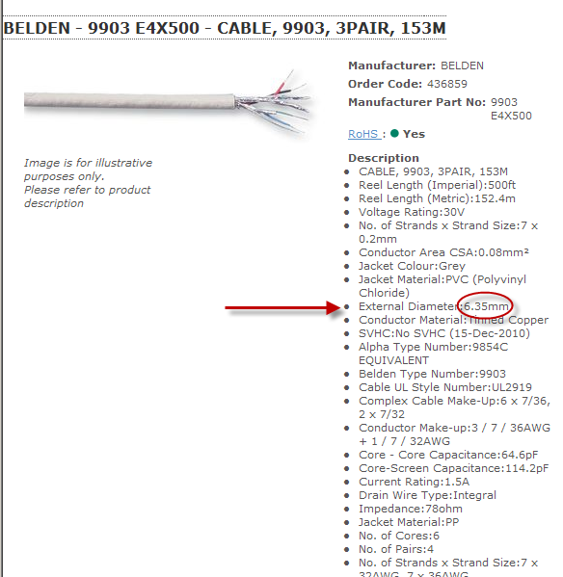
Again 103 or 104 series Decision.?

Slide 16
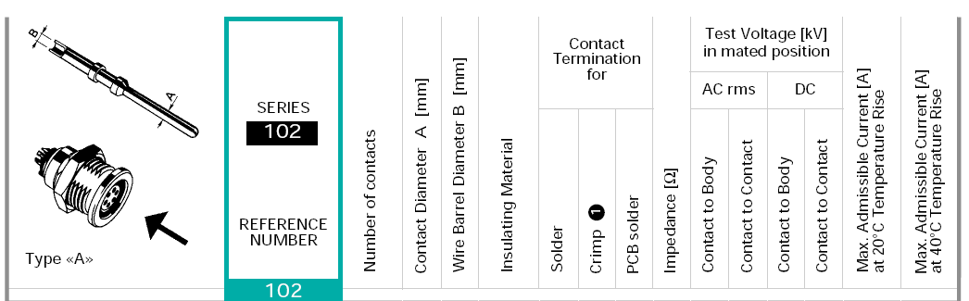
5. Serial- 4 way. Signal 4 core screened
Low Volts – Power current

Slide 17
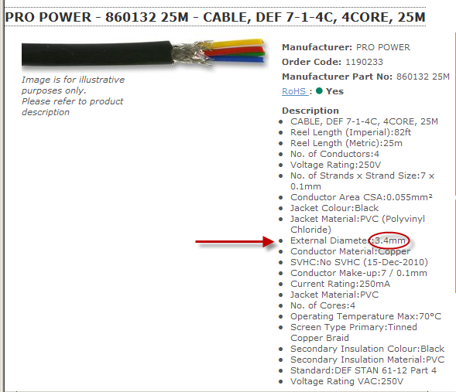
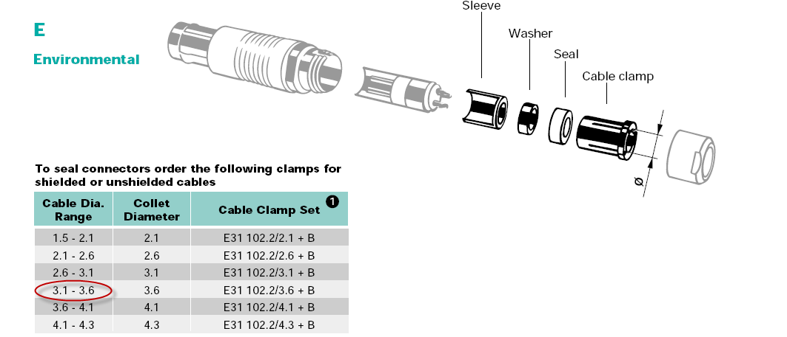

Slide 18
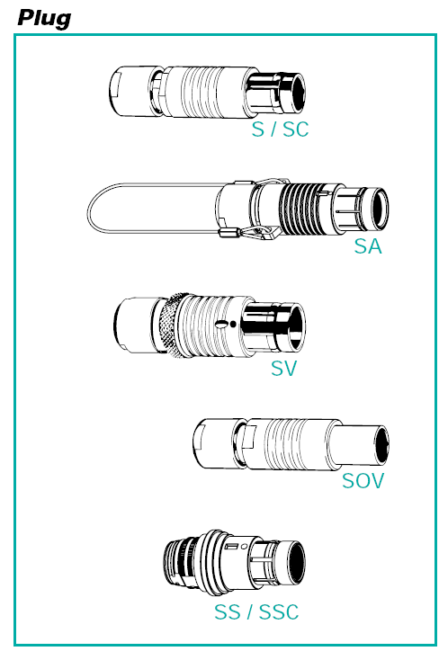
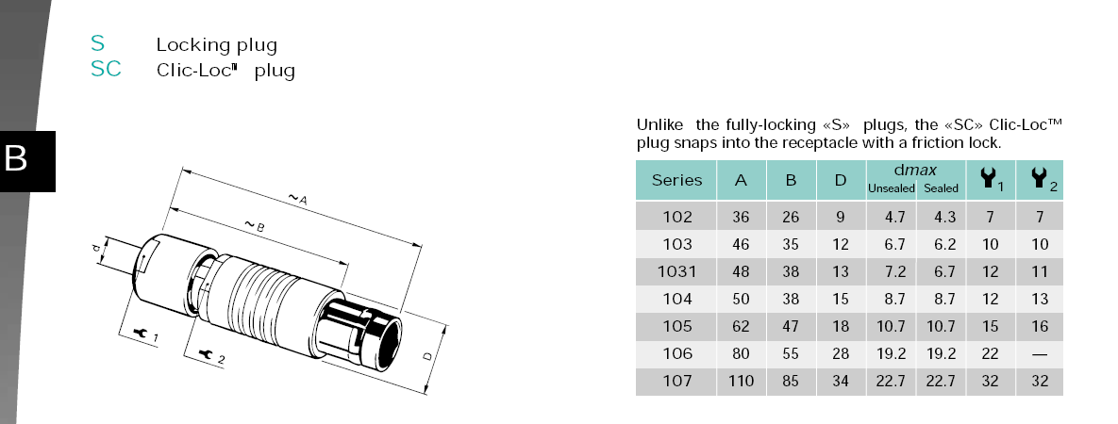

Slide 19
